Slide 1
Processes and Threads
Week 2

Slide 2
Processes and Threads
A program is a recipe. A process is someone actually cooking it
  One program can run as several processes, such as two windows of the same app
A process is a program in memory that is running, or waiting for the CPU, I/O, or another service
Computers do many things at once: play music, load a web page, download a file, and check email
  Processes let the OS keep track of all of them
Notes:
Microsoft: About processes and threads: https://learn.microsoft.com/en-us/windows/win32/procthread/about-processes-and-threads

Slide 3
What's Inside a Process
Each process gets its own private section of memory, called its address space
  Code (text): the instructions the CPU runs
  Data: the information the program is working with
  Stack: the program's to-do list, tracking which task it's in the middle of
One process can't read another process's memory, which keeps programs from interfering with each other

Slide 4
Process Creation
A new process is created when:
  You open an app or type a command
  A user logs in
  The system starts a service at boot. On Linux, systemd does this
  A running process creates another one
A process is created if there's enough memory, and it waits if other resources it needs aren't available
Notes:
systemd: https://systemd.io/

Slide 5
Process Behavior
A process needs the CPU and I/O at different times, and usually has to wait for them
The OS keeps a waiting line (queue) for each of these services
At one moment a process may be in line for the CPU, and later in line for the drive or the network
When it has finished everything it needs to do, the process ends (terminates)

Slide 6
Process States
New: being created
Ready: waiting in line for the CPU
Running: using the CPU right now
Blocked (waiting): waiting for I/O or some other event, like a file to load or a key press
Terminated: finished, and being cleaned up
Some systems add suspended states for processes moved out of memory (next slides)

Slide 7
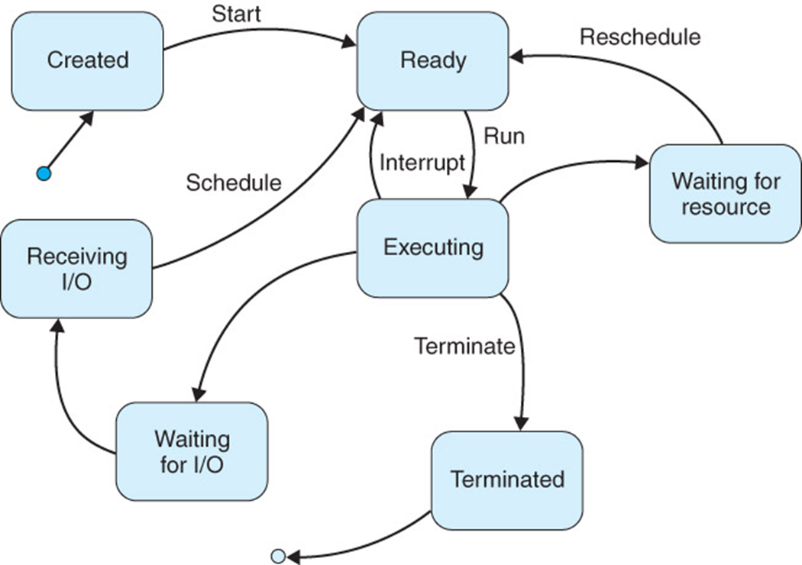
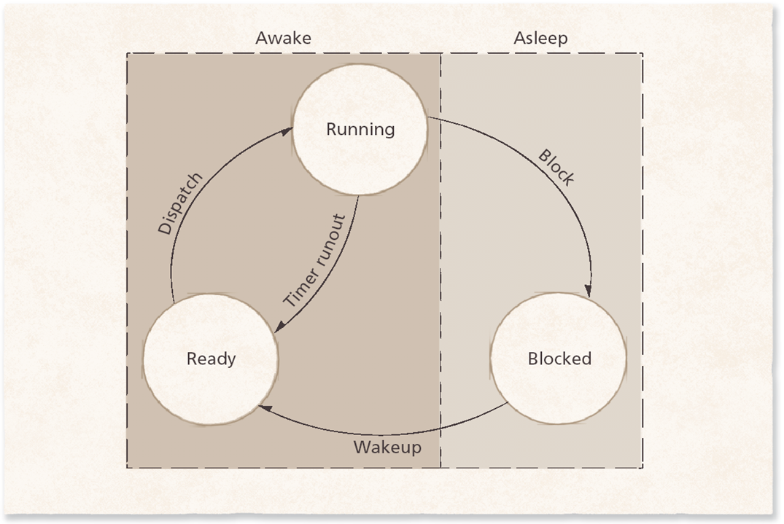
Process State-Transition Diagram Basic

Slide 8
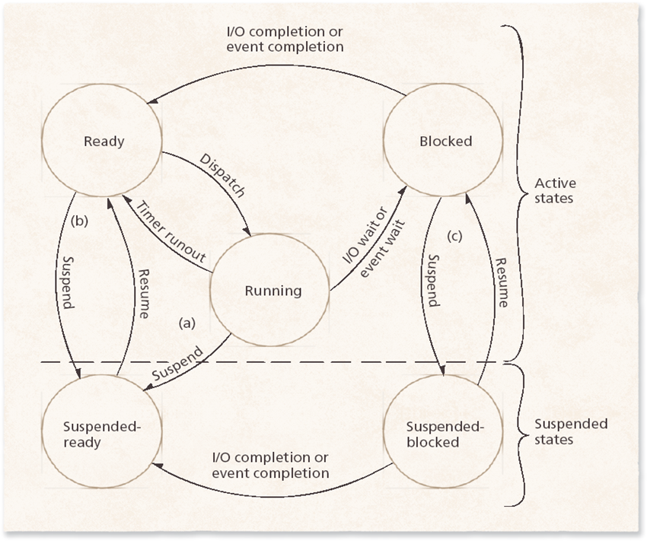
Process State-Transition Diagram

Slide 9
Process States on Linux
ps and top show each process's state as a letter
  R: running, or ready to run
  S: sleeping (blocked, waiting for an event)
  D: waiting on a device, usually the disk, and can't be interrupted
  T: stopped, such as after pressing Ctrl+Z
  Z: zombie. Finished, but its parent hasn't collected its exit status yet
A few zombies are harmless. Lots of them usually means a buggy parent program
Notes:
Linux manual page: ps: https://man7.org/linux/man-pages/man1/ps.1.html

Slide 10
Process Control Block (PCB)
The PCB holds everything the OS needs to manage a process, such as:
  Process ID number (PID)
  Process state
  Program counter: where it is in the code
  Scheduling priority
  Credentials: which user it runs as
  Its parent process and child processes
  Where its code and data are in memory
  Resources it has, such as open files
On Linux, the PCB is called the task_struct

Slide 11
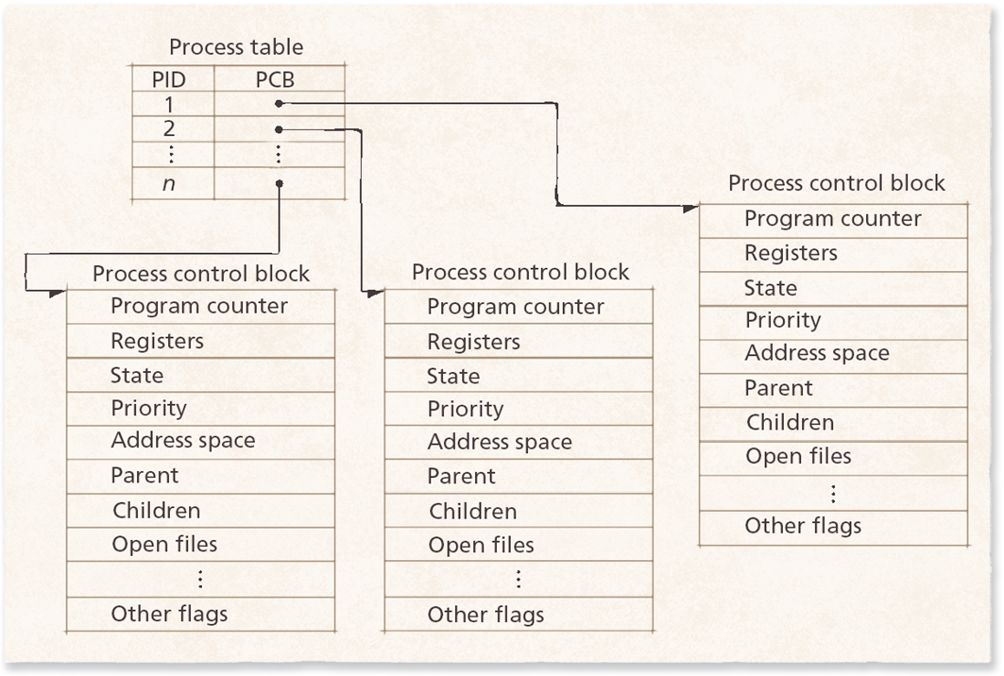
PCB Example

Slide 12
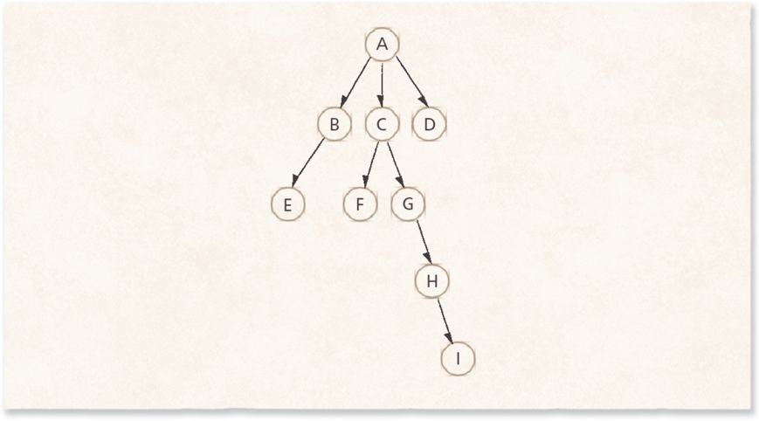
Process Operations
A process may create (spawn) a new process
  The creating process is the parent, and the new one is the child
  Each child has exactly one parent, so processes form a tree
When a parent ends, the OS either ends its children too, or lets them keep running
  On Linux, orphaned children are adopted by process 1 (systemd)

Slide 13
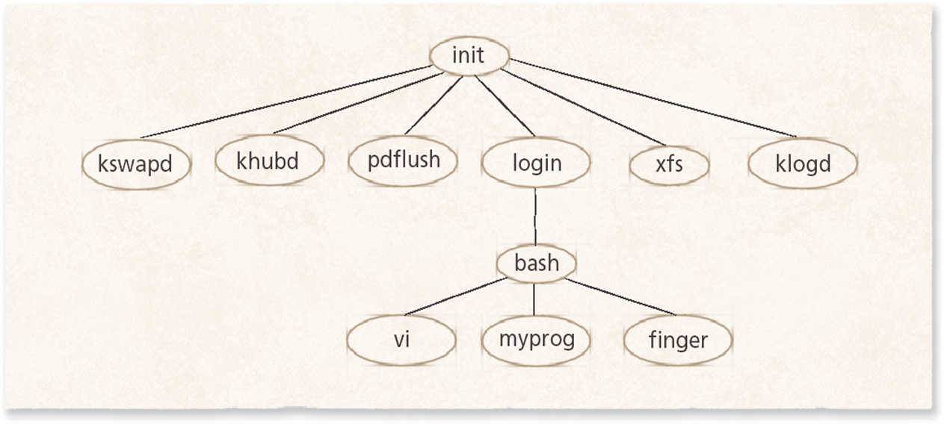
Process Tree Example: Linux
Historical note: this older tree starts with init, and shows kernel helpers like khubd and pdflush that modern Linux no longer has
Today most distros start systemd as process 1, and it starts everything else
Run pstree to see your own system's tree
Notes:
Linux manual page: pstree: https://man7.org/linux/man-pages/man1/pstree.1.html

Slide 14
Interprocess Communication (IPC)
Processes often need to share data or work together
Common ways:
  Pipes: one program's output feeds into the next. In a Linux shell, ls | grep txt is a pipe
  Signals: short alerts. Ctrl+C sends one to stop a program, and kill sends one to a process ID
  Sockets: connections between processes, even on different computers. This is how your browser talks to websites
  Shared memory: two processes share one section of memory
Notes:
Linux manual page: pipe: https://man7.org/linux/man-pages/man7/pipe.7.html
Linux manual page: signal: https://man7.org/linux/man-pages/man7/signal.7.html

Slide 15
Message Passing
One process sends a message, and another receives it
  Messages can go one way, or both ways
Blocking: the sender waits until the message is received
Nonblocking: the sender keeps working without waiting
Like a phone call, where you wait for an answer, compared with a text message, where you send it and keep going

Slide 16
Processes on Linux and Unix
Every process has a process ID (PID) and its own private memory space
The kernel keeps each PCB in protected memory that programs can't touch
Processes ask the kernel for help through system calls (Week 1)
fork creates a copy of a process. This is how the shell starts each command you type
Nice values run from -20 to 19. Lower numbers mean higher priority
  nice and renice change them, and top shows them in the NI column
Notes:
Linux manual page: nice: https://man7.org/linux/man-pages/man1/nice.1.html

Slide 17
Seeing and Stopping Processes
Windows: Task Manager (Ctrl+Shift+Esc). Select a frozen app and choose End task
macOS: Activity Monitor, or Force Quit (Option+Command+Esc)
Linux: top, htop, or ps aux show what's running
  kill followed by a process ID asks a program to stop. kill -9 forces it
Forcing a program to quit can lose unsaved work, so try closing it normally first
Notes:
Microsoft Learn: Task Manager: https://learn.microsoft.com/en-us/shows/inside/task-manager
Apple: How to force an app to quit: https://support.apple.com/en-us/102586
htop: https://htop.dev/
Linux manual page: kill: https://man7.org/linux/man-pages/man1/kill.1.html

Slide 18
Modern Apps Use Many Processes
Web browsers run websites in separate processes
  Chrome calls this Site Isolation, and Firefox calls it Project Fission
  One crashed tab doesn't take down the others, and a bad site can't easily read another site's data
That's why Task Manager may show dozens of browser processes
Phones stop background apps to save battery and memory
  Android and iOS can end an app you aren't using, and restart it when you come back
Notes:
Chromium: Site Isolation: https://www.chromium.org/Home/chromium-security/site-isolation/
Mozilla: Project Fission: https://wiki.mozilla.org/Project_Fission
Android: Processes and app lifecycle: https://developer.android.com/guide/components/activities/process-lifecycle
Apple: Managing your app's life cycle: https://developer.apple.com/documentation/uikit/managing-your-app-s-life-cycle

Slide 19
Threads
A thread is one path of work inside a process
  If a process is a kitchen, threads are the cooks: they share the space and ingredients, but each does a different task
Threads share the process's code, memory, and open files, but each has its own place in the code and its own stack
Most programs today use several threads
  A game can draw graphics, play sound, and load the next level at the same time
Why threads?
  Easier to split up work that can happen at once
  Spread work across several processor cores
  Sharing memory is faster than passing messages between processes

Slide 20
Threads in a Process
The OS manages both processes and threads
Switching between threads is faster than switching between processes, because they share memory
Each thread has a small record of its own (a thread descriptor): ID, state, priority, and its stack
A process starts with one thread, the main thread, and can create more

Slide 21
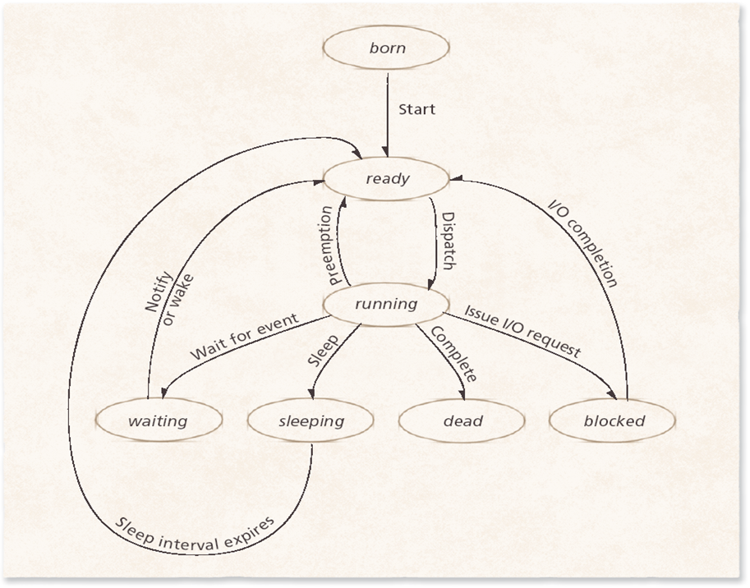
Life Cycle of a Thread

Slide 22
Threading Models
Who manages the threads, the program or the kernel?
  User-level threads: the program manages them
  Kernel-level threads: the operating system manages them
  A mix of both (many-to-many)
Today, Linux and Windows use one-to-one: every thread is a kernel-level thread
Programmers create threads with libraries, such as POSIX threads (Pthreads) on Linux, or Java's thread classes
Notes:
Linux manual page: pthreads: https://man7.org/linux/man-pages/man7/pthreads.7.html

Slide 23
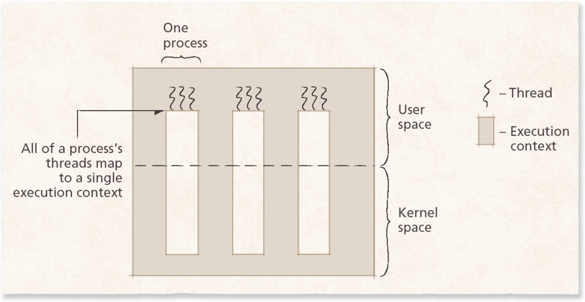
User-level Threads
The program manages its own threads with a thread library, and the kernel doesn't know they exist
Fast to create and switch between
But if one thread blocks, the whole process blocks, and it can only use one core

Slide 24
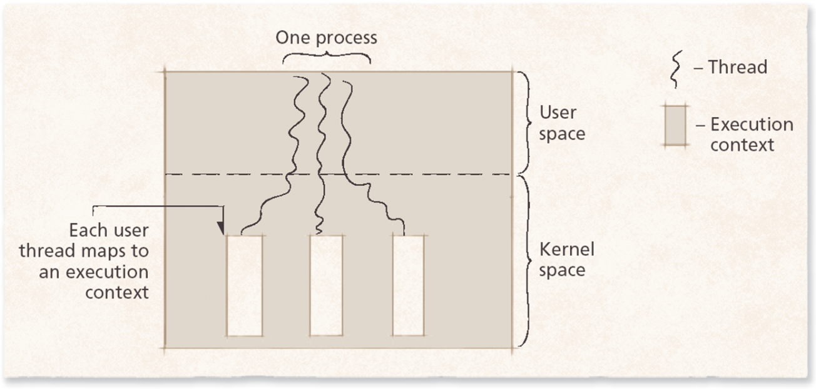
Kernel-Level Threads
The kernel creates and schedules each thread
If one thread blocks, the others keep running
Threads can run on several cores at the same time
Linux and Windows work this way today (one-to-one)

Slide 25
Combining User- and Kernel-level Threads
Many-to-many: many user threads share a smaller number of kernel threads
Historical note: popular in older systems like Solaris, but Linux and Windows moved to one-to-one. Still worth knowing because it's back: Go's goroutines and Java's virtual threads (2023) work this way
Thread pools: worker threads that stay ready, so new tasks don't wait for a thread to be created. Web servers use them
Scheduler activations: the kernel tells the program's thread library when one of its threads blocks, so the library can run another
Notes:
Java: JEP 444, Virtual Threads: https://openjdk.org/jeps/444

Slide 26
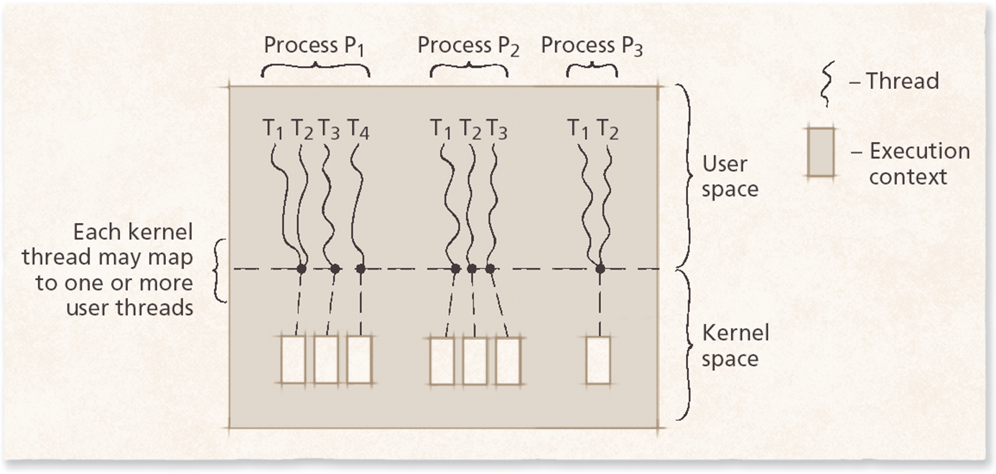
Combining User- and Kernel-level Threads

Slide 27
Multi-Core Processors
A core is a complete processor, and most computers and phones today have several
Each core can run a different thread at the same time
Hyper-threading (simultaneous multithreading) lets one core juggle two threads
Newer chips mix fast performance cores with power-saving efficiency cores
  Apple silicon, recent Intel Core chips, and most phone processors do this
  The OS decides which threads go on which cores (Week 5, Processor Scheduling)
Notes:
IBM: What is a CPU?: https://www.ibm.com/think/topics/central-processing-unit
Intel: How Intel Core processors work: https://www.intel.com/content/www/us/en/gaming/resources/how-hybrid-design-works.html

Slide 28
Interrupts and Context Switches
The CPU switches between processes so fast it looks like they all run at once
  Running many processes this way (multiprogramming) is covered in Week 4
Interrupt: a signal that makes the CPU stop and deal with something
Context switch: the CPU saves one process and loads another
The scheduler decides which process runs next (Week 5)

Slide 29
Context Switch
The OS saves the current process's state (its place in the code, its registers, and more) into its PCB, then loads the next one's
Like putting a bookmark in one book before picking up another
Switching is overhead: time spent switching instead of doing real work
How fast it is depends on the hardware

Slide 30
Interrupts
Interrupts let the system respond to events right away, instead of constantly checking (more on this in the Storage, I/O, and Backups week)
Traps: caused by the running program itself, such as dividing by zero or touching memory it isn't allowed to use
Hardware interrupts: caused by outside events, such as a key press, a mouse move, or a finished download
Handling an interrupt:
  The CPU finishes its current instruction and pauses the process
  It runs the kernel's interrupt handler, found in a table called the interrupt vector
  Then it goes back to the process, or switches to another one

Slide 31
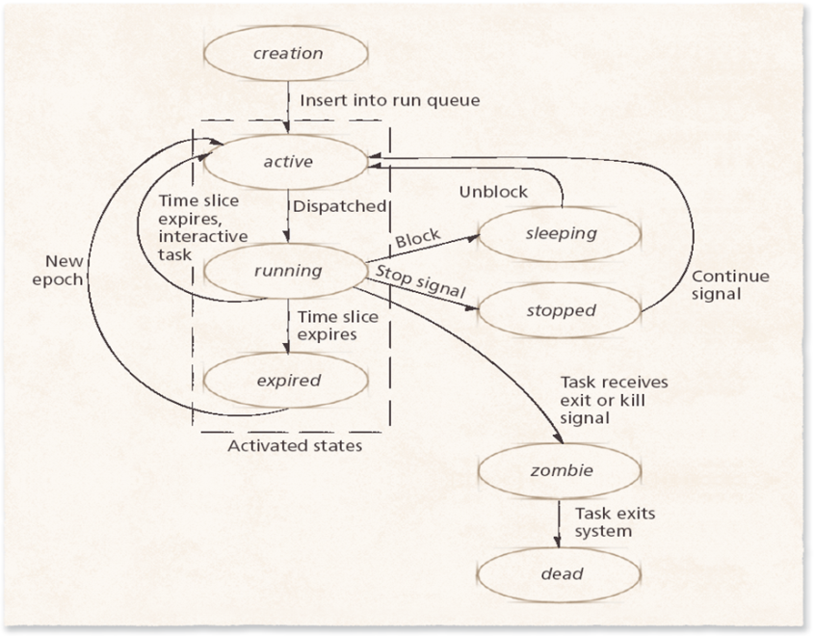
Linux Threads
Linux treats processes and threads the same way: both are tasks
fork creates a new process. clone creates a new task and chooses what to share with the parent
  Share everything, and the new task is a thread
See threads with top -H or ps -eLf
The picture shows the states a Linux task moves through
Notes:
Linux manual page: clone: https://man7.org/linux/man-pages/man2/clone.2.html

Slide 32
Containers: Groups of Processes
A container is a group of processes kept separate from the rest of the system
  They get their own view of files, the network, and other processes
Containers share the host's kernel, so they start fast and use little memory
Docker and Kubernetes run apps this way. More in Week 14, Virtual Machines
Notes:
Red Hat: What is a Linux container?: https://www.redhat.com/en/topics/containers/whats-a-linux-container

